Slide 1

The Greetings Song

Slide 2
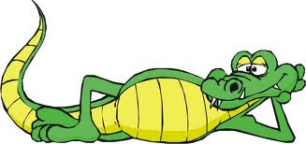
Good morning
Good morning.

Slide 3
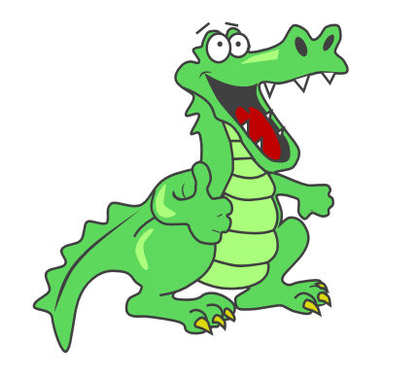
Good afternoon

Slide 4

Good evening
Good evening.

Slide 5

Good night. Good Night!

Slide 6
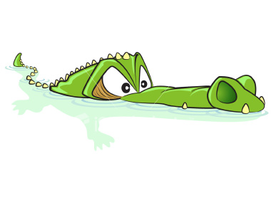
Nice to meet you.
Nice to meet you too!

Slide 7
Good bye, good bye.

Slide 8
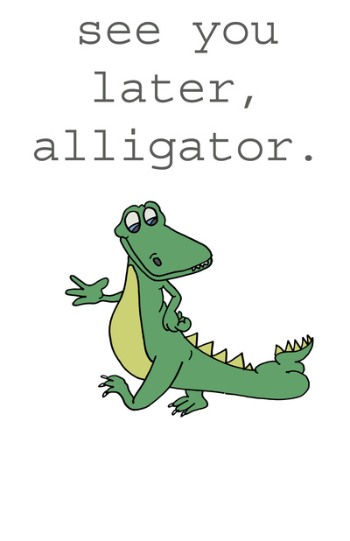

See you!

Slide 9
Good morning, good morning.
Good afternoon.
Good evening, good evening.
Good night, good night.
Nice to meet you!
Nice to meet you too!
Good bye, good bye, see you!

Slide 10
Good morning
Good morning.

Slide 11
Good afternoon

Slide 12
Good evening
Good evening.

Slide 13
Good night. Good Night!

Slide 14
Nice to meet you.
Nice to meet you too!

Slide 15
Good bye, good bye.

Slide 16
See you!

Slide 17
See you later!

Slide 18
Can be sung using
the YouTube song:
http://www.youtube.com/watch?v=gVIFEVLzP4o&list=PL4100F23F763190B0&index=5&feature=plpp_video
The Greetings Song

